Slide 1

AE 755: Optimisation of Engineering Design
Optimisation Project
Sixteem
(Stage 4)

Slide 2
Problem statement:
Place the given light sources in such a way that it illuminates the wall with uniform intensity
Assumptions:
Dimensions of the room, total number of bulbs, power of each bulb are to be provided by user while using the optimizer designed (3 ≤ n ≤ 5)
Here a, b, c are dimensions of room provided by the user
Walls are non-reflective
Light bulbs are considered to be point sources which are used for lighting
Thickness of the walls is considered very small. Wall is opaque (you can’t see through the other side of the wall)
We will calculate the intensity for discrete points equally distributed on the wall

Slide 3
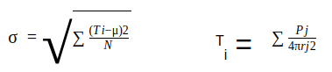
Mathematical Formulation:
The objective function is the standard deviation of the intensity of light sources on the wall as given below:
Objective Function:
where
T_{i} = Intensity at i^{th} point on the wall
μ = Mean of intensities at all points
N = Number of points
P_{j} = Power of j^{th} bulb
r_{j} = Radial distance of i^{th} point from j^{th} bulb

Slide 4
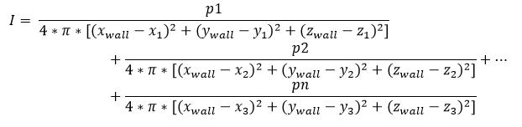
Equation for finding Intensity:
def Intensity(x1,y1,x2,y2,x3,y3,z1,z2,z3,x_wall,y_wall,z_wall):
Intensity() is used to calculate intensity at a specific point (x_wall, y_wall,z_wall) on the wall which serves as our COST FUNCTION.

Slide 5
Design Variables : x₁, x₂.. x_{n}, y₁ , y₂.. y_{n}, z₁, z₂..z_{n} (n - number of bulbs)
Parameters : a, b, c, n, P1, P2.. , Pn
Constraint :
0<x<a; 0<y<b; 0<z<c
ax+by+cy > constant
For example, in blackboard case: ax+by+cz<0 or >0 so that all the bulbs lie on the same side of the blackboard.
Search Algorithms to be implemented:
Genetic Algorithm
Simulated Annealing
Particle Swarm
We will be using python as our programming language.

Slide 6
Steps to be followed:
Divide the plane into small squares at the center of whom we will be finding the intensities of respective bulbs
No. of squares is not fixed rather the size of each square is as resolution would otherwise get worsened
After getting the intensities, we feed the standard deviation of the same as our cost function to the various search algorithms (Genetic Algorithm and Gradient Descent Steepest Descent) to get the minima of the cost function
The resulting minima gives us the values for respective bulbs (x, y, z coordinate) where the bulbs must be placed for uniform lighting.
We will also try to keep the intensity of light in the room above a given threshold value so that even after uniform lighting, the room is well-lit.

Slide 7
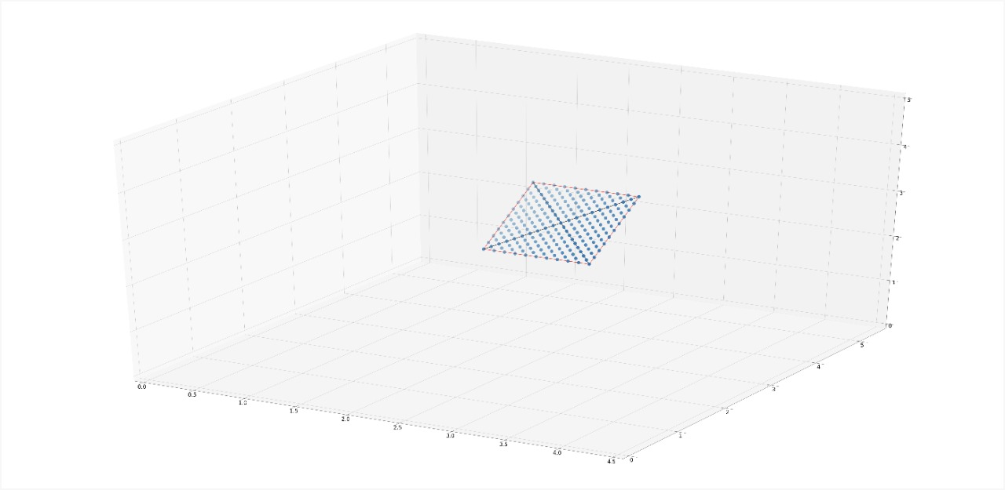
Grid formation

Slide 8
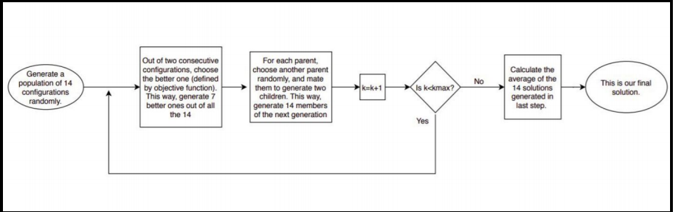
1) Genetic Algorithm
Optimization Algorithms Used:

Slide 9
Pseudo Code for Genetic Algorithm
def generating_random_values(no_of_bulbs,no_of_co_ordinates_to_be_taken):
#generating random values of the co-ordinates of the bulb within the range of the room
#return the pairs of co-ordinates in the form of [(x1,y1,z1),(x2,y2,z2),..] for each bulb - constitute a set
initial_population = []
for i in range(no_of_co_ordinates_to_be_taken->must be an even number (simplicity)):
initial_popultion.append([(x_i1,y_i1,z_i1),(x_i2,y_i2,z_i2),(x_i3,y_i3,z_i3)])
return initial_population
def fitness_value(no_of_bulbs,no_of_random_co_ordinates_to_be_taken):
#Define the fitness function
#Take "J" and compute fitness from there using the points generated from the "generating_random_value" function
#return the fitness value for each pair of the co-ordinates taken
J = std_deviation(intensity_at_different_points)
parents = []
for i in range(parent_set):
if J[one_value]>J[another_value]:
parents<-another_value
else:
parents<-one_value
return parents

Slide 10
def crossover(parent1,parent2):
# If probability greater than threshold then only
#Randomly take some values (genes) from the one pair, transfer it to another pair and vice versa
#return the offspring
for i in range(total_parameters_in_one_parent,i.e.,9):
x= random_value_less_than_1
if x > threshold:
#swap two numbers program
#in the process, the better set of parents taken from fitness_value function is retained
temp = parent1[i]
parent1[i] = parent2[i]
parent2[i] = temp
return parent1(,i.e.,child1), parent2(,i.e.,child2) (new_offsprings)
def mutation(child1):
# randomly mutate the genes in the offspring
# Compute its fitness value and replace it with the lowest fitness probability pair which were take earlier
#updating the new set
for genes in range(chromosome_of_child):
if probability>threshold(small_value):
child1[gene]<-changed at a value randomly within the range of room
return child1

Slide 11
def genetic_algorithm(obtained_parent_set):
for loop with a particar number of iterations:
#taking the function mentioned above in the order
fitness_value(required_arguements)
for i in range(no_of_parents/2):
child1, child2 = crossover(required_arguements)
for loop for each child:
mutation(required_arguements)
#replacing the offsprings in the original set with the speicess having low fitness value
original_set<-child1, child2
return better_set (original_set_with_fittest_species)
#returns the fittest value

Slide 12
2) Pseudo Code for Simulated Annealing
FUNCTION simulated annealing:
Generate random initial position of bulbs within the bounds of the room
Evaluate the objective function at these positions
Store the initial position and objective function value as CURRENT POSITION and CURRENT VALUE
Initialize BEST POSITION and BEST VALUE as CURRENT POSITION and CURRENT VALUE
FOR i in RANGE (no. of iterations):
Find UPDATED POSITION by taking a step with respect to CURRENT POSITION
(Ensure it is within bounds)
Evaluate objective function at UPDATED POSITION as UPDATED VALUE
IF UPDATED VALUE < BEST VALUE:
BEST POSITION = UPDATED POSITION
BEST VALUE = UPDATED VALUE
PRINT BEST POSITION , BEST VALUE
DIFFERENCE = UPDATED VALUE - CURRENT VALUE
Calculate TEMPERATURE for current epoch : TEMPERATURE= (INITIAL TEMPERATURE)/(i+1)
Metropolis acceptance criteria : METROPOLIS=exp⁡(-DIFFERENCETEMPERATURE)
IF DIFFERENCE < 0 OR probability < METROPOLIS :
CURRENT POSITION = UPDATED POSITION
CURRENT VALUE = UPDATED VALUE
RETURN BEST POSITION, BEST VALUE

Slide 13
Genetic Algorithm

Slide 14
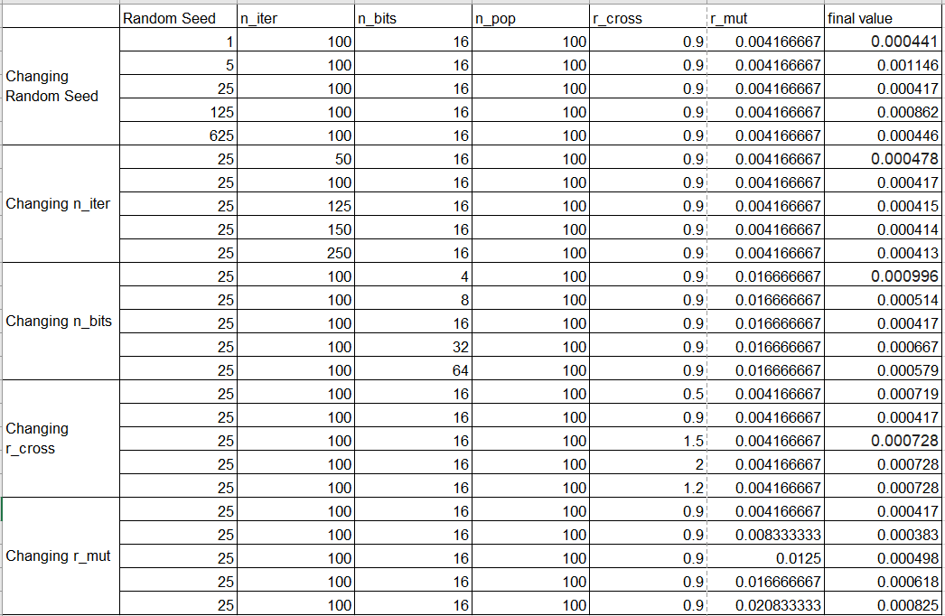

Slide 15
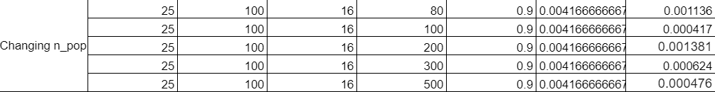

Slide 16
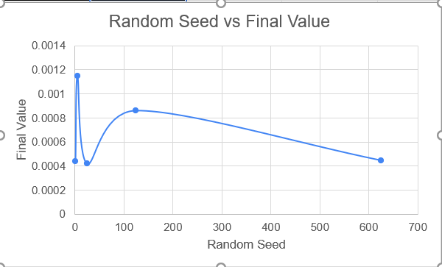
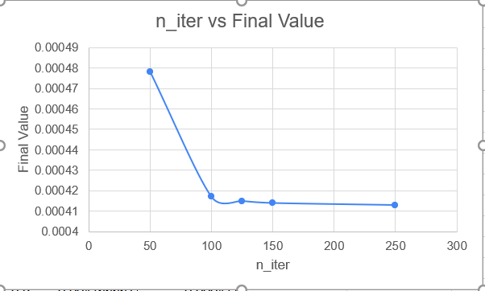
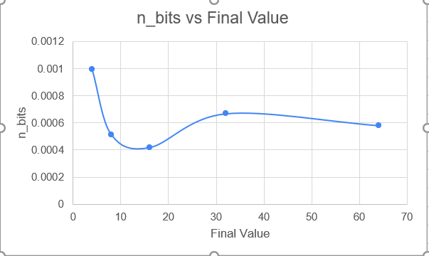
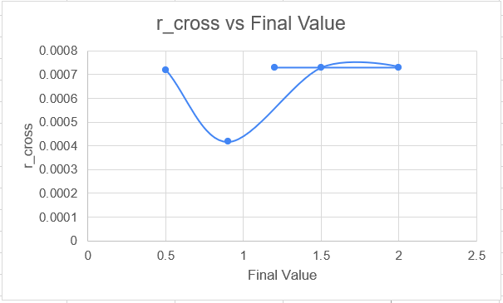

Slide 17
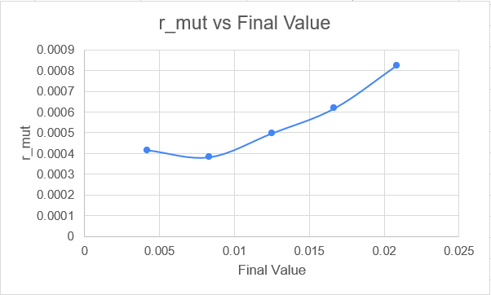

Slide 18
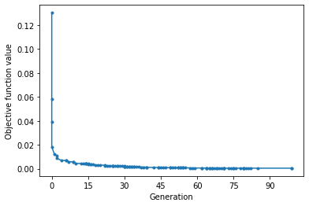
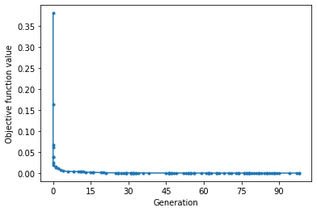
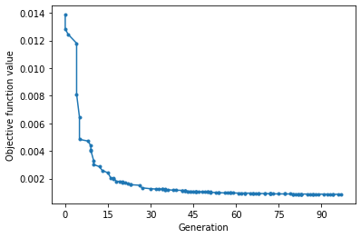
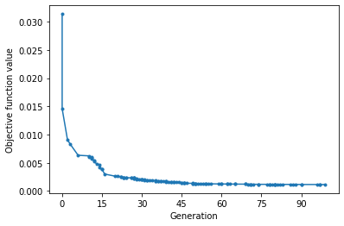
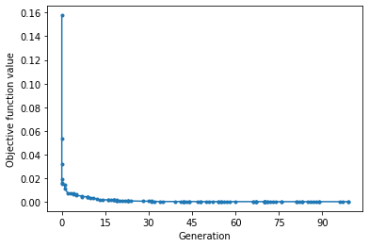
Changing Random Seed

Slide 19
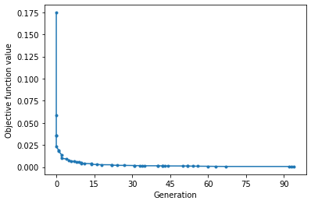
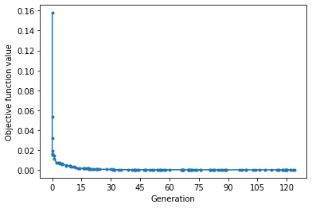
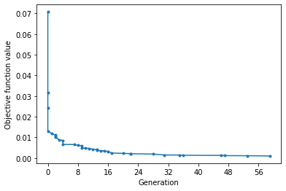
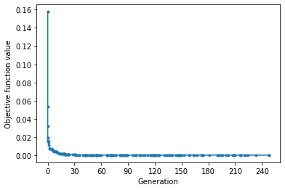
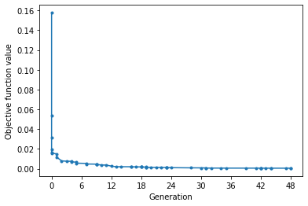
Changing n_iter

Slide 20
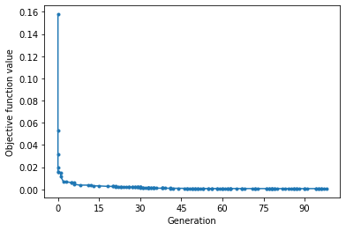
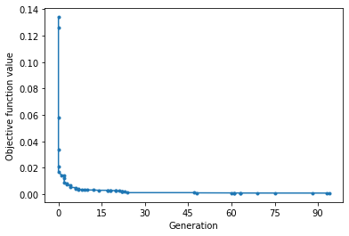
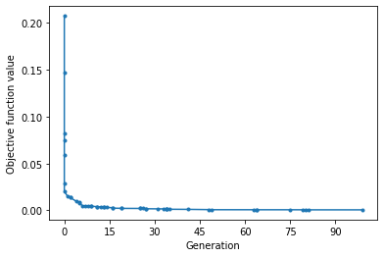
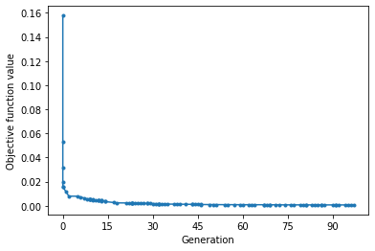
Changing n_bits

Slide 21
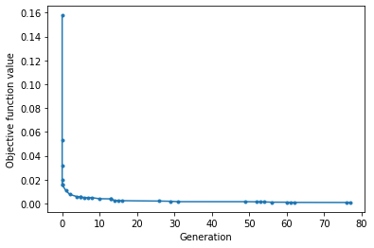
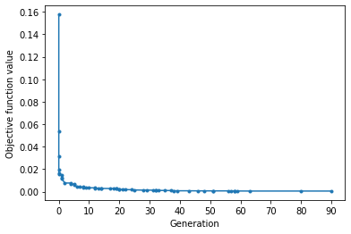
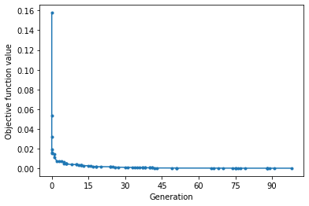
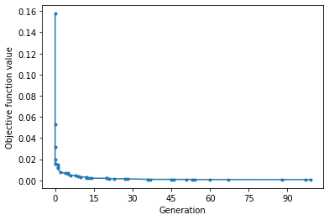
Changing r_cross

Slide 22
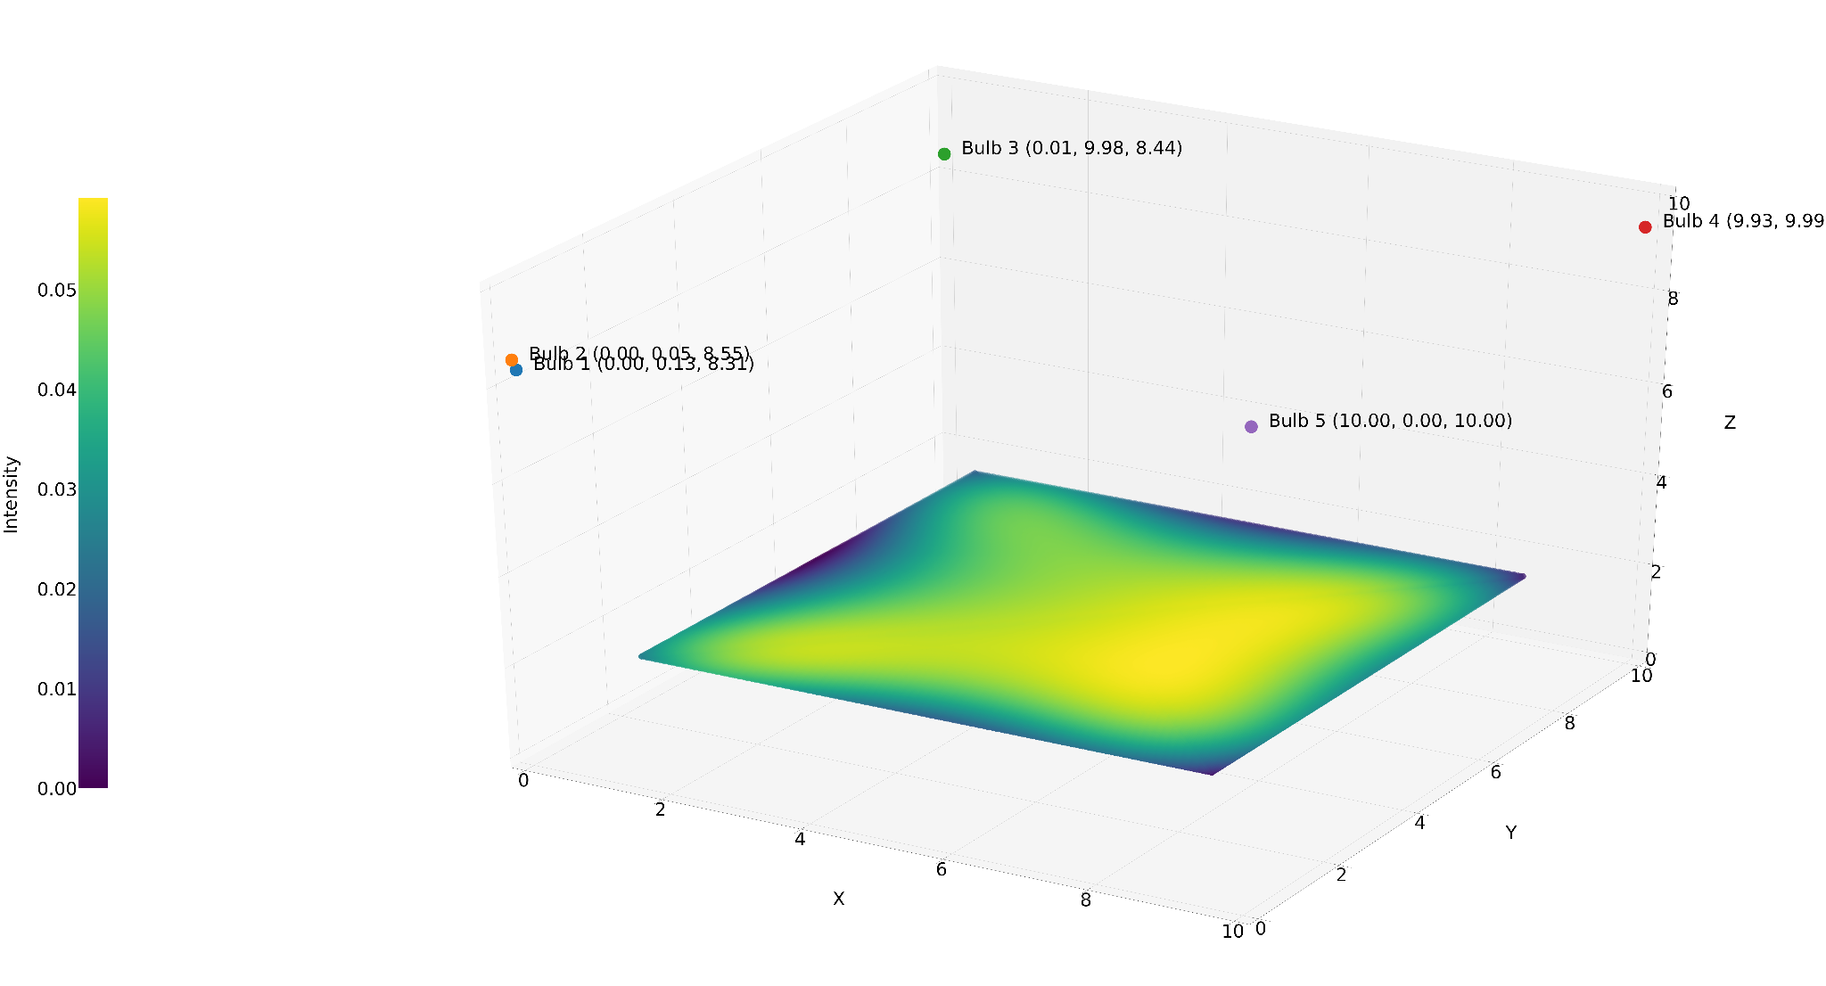
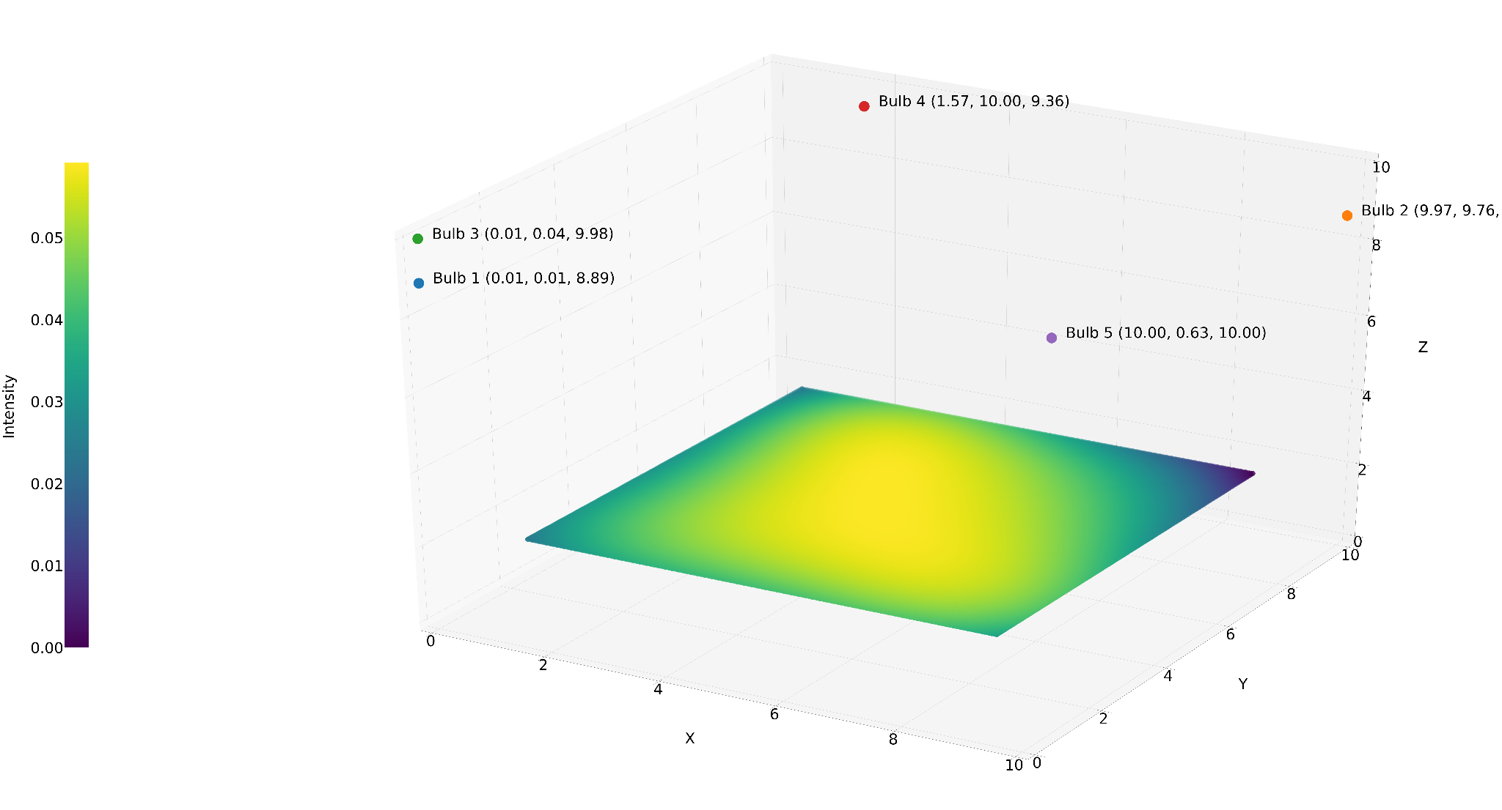
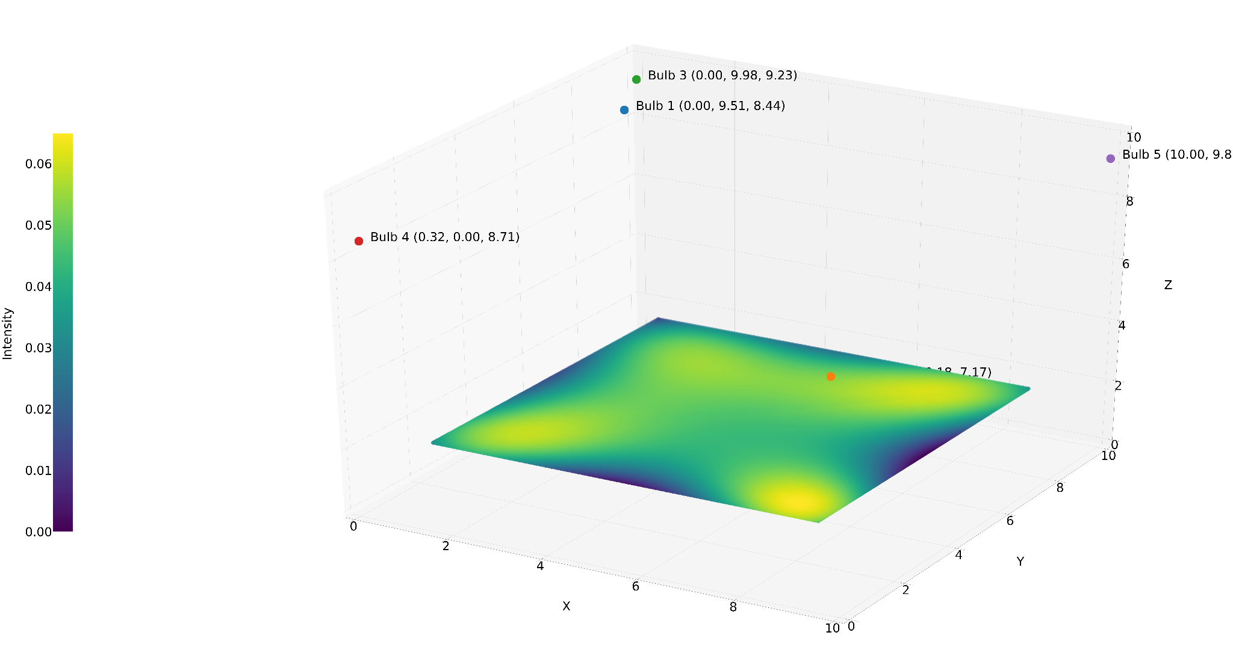
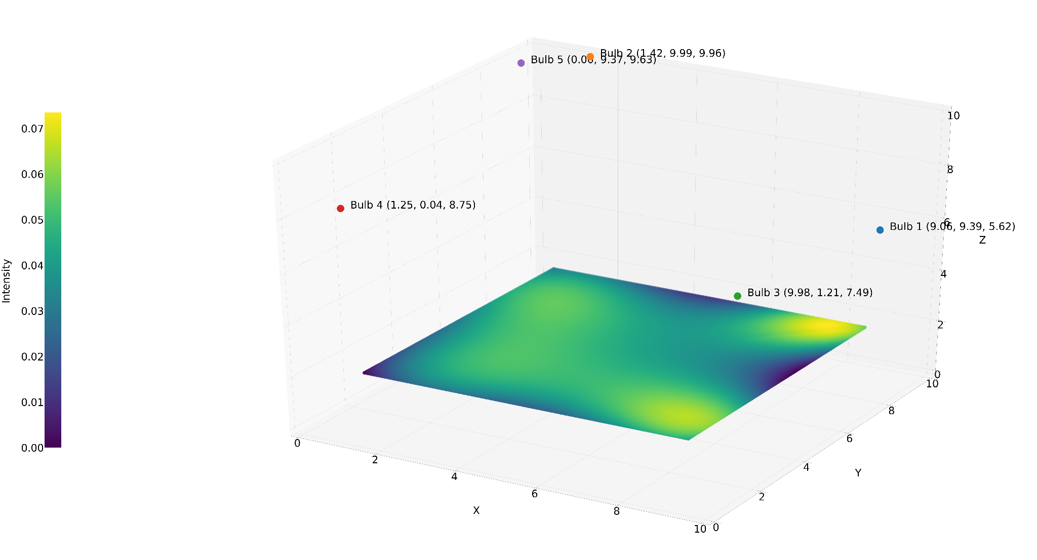
Changing Random Seed

Slide 23
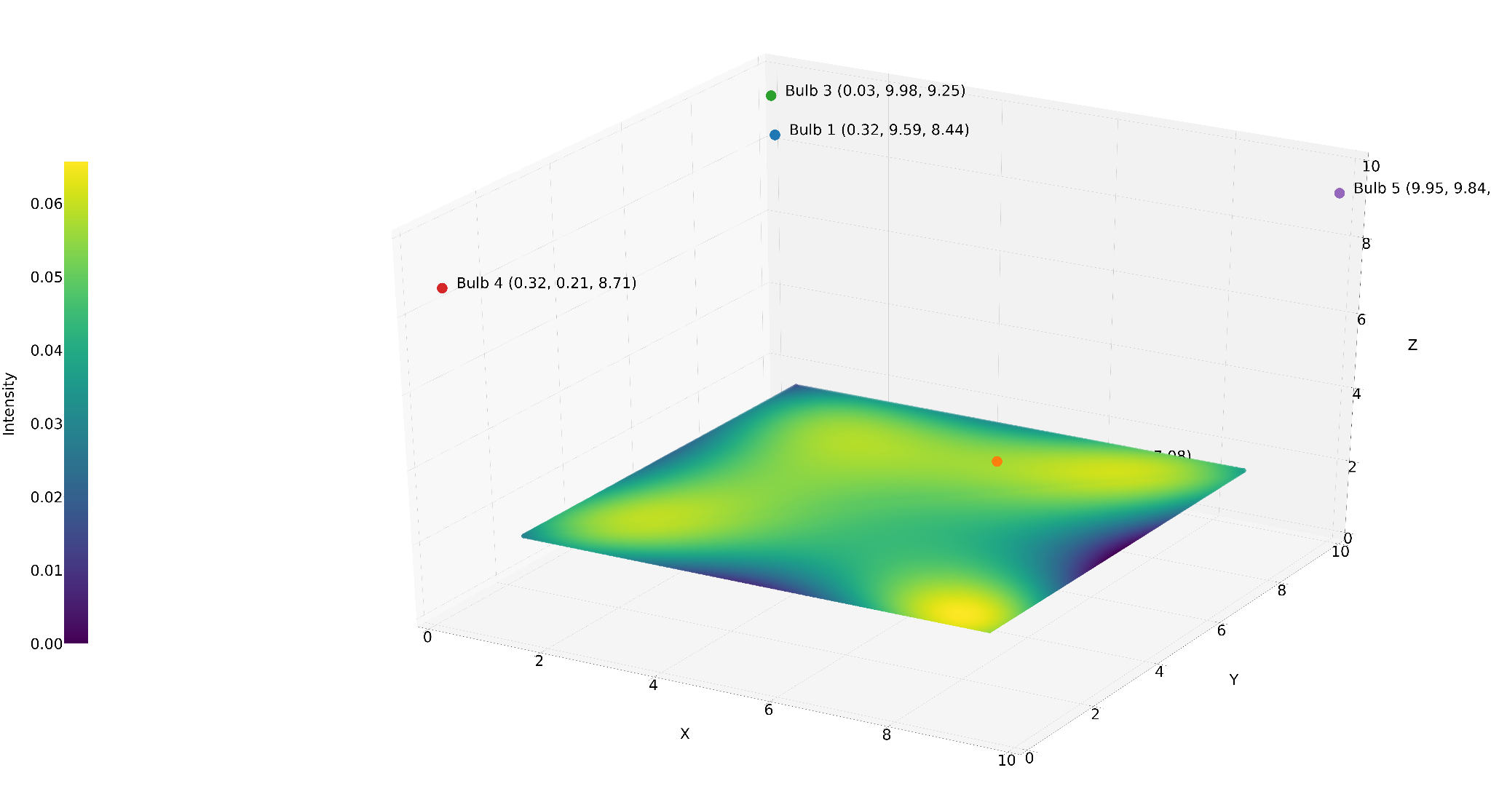

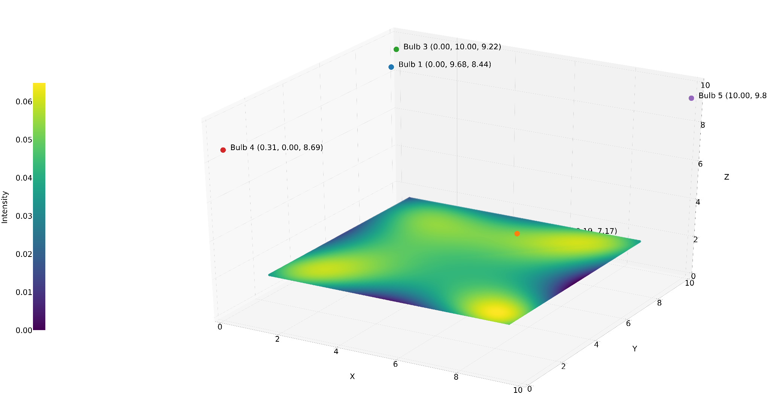
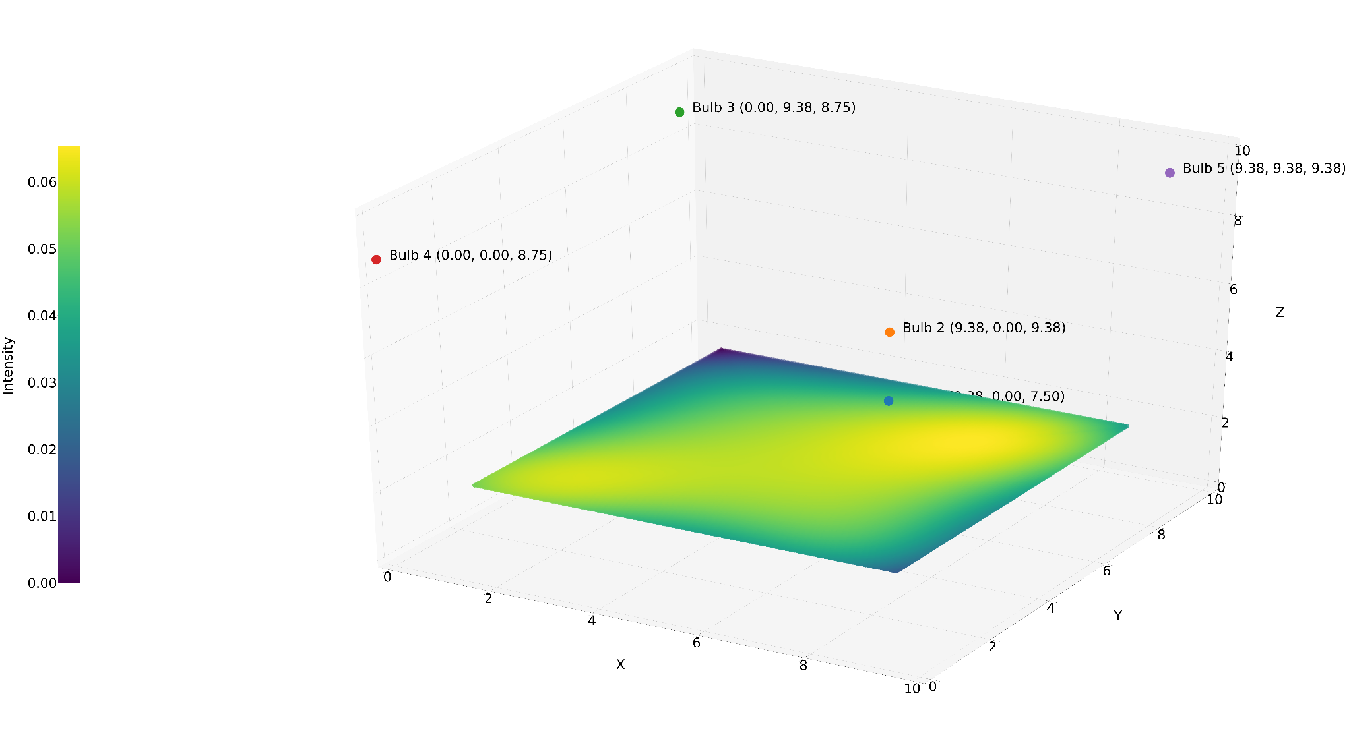
Changing n_iter

Slide 24
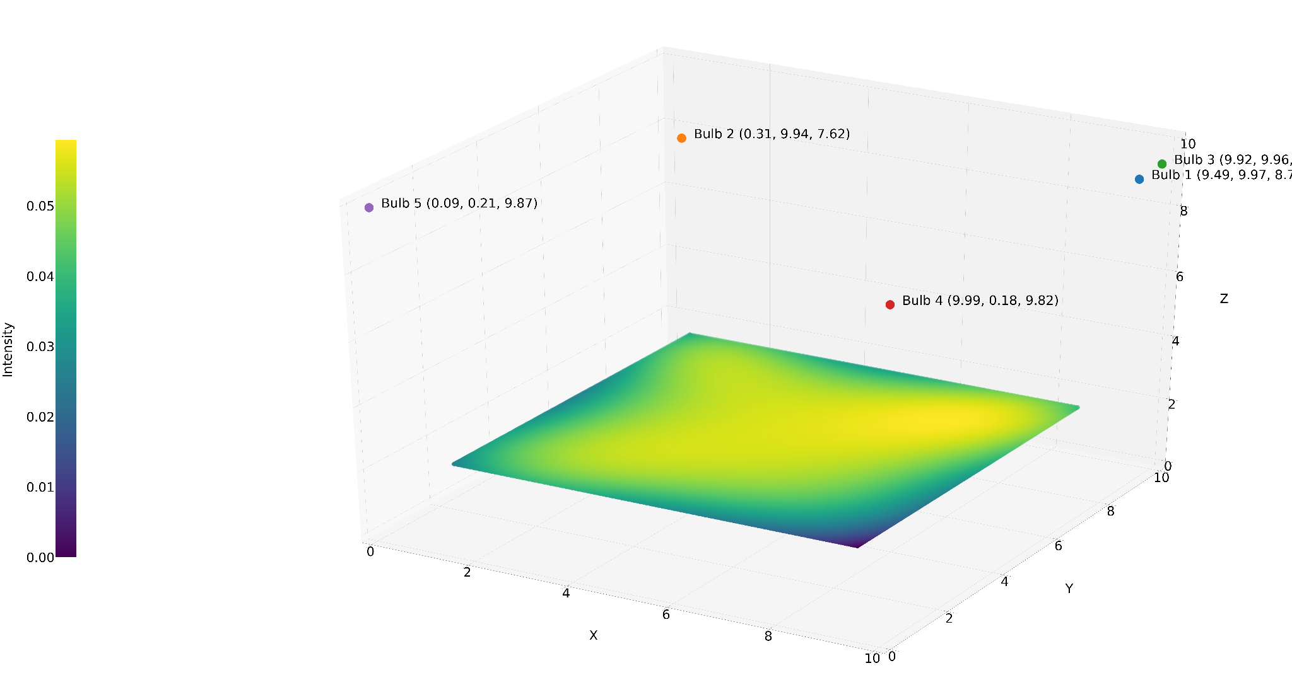
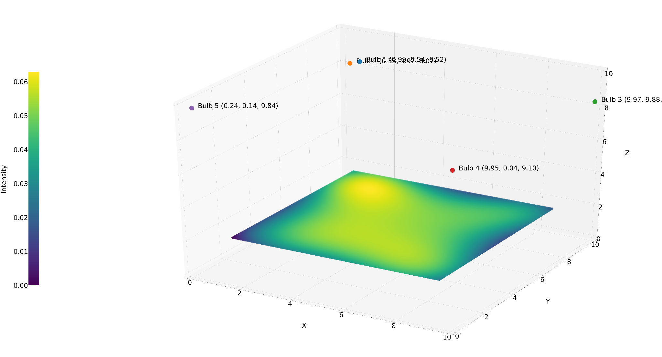
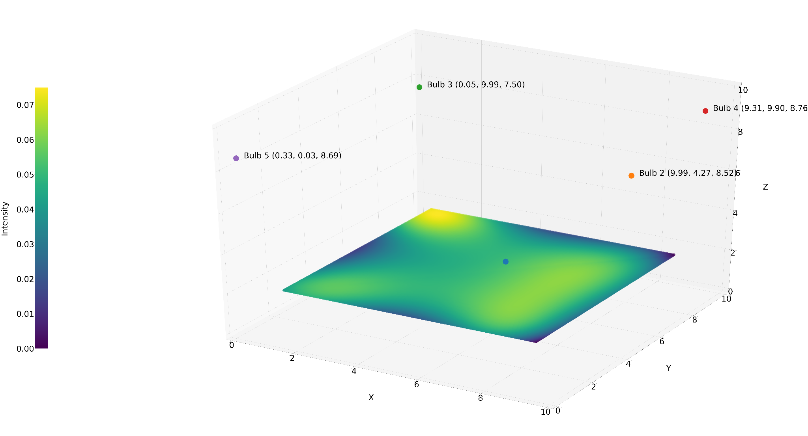
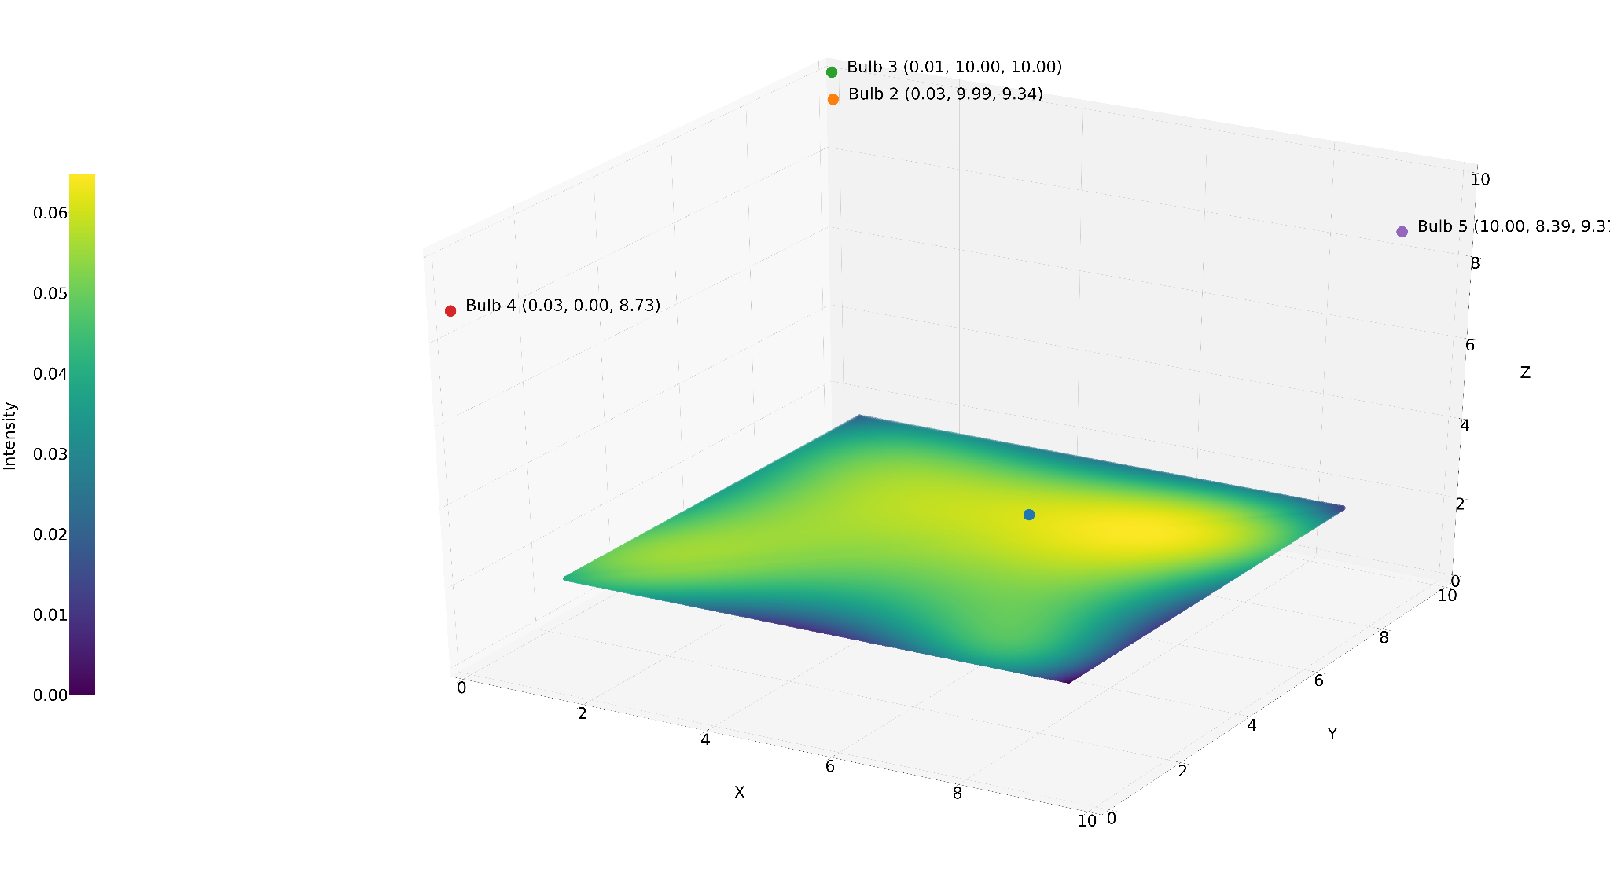
Changing n_bits

Slide 25
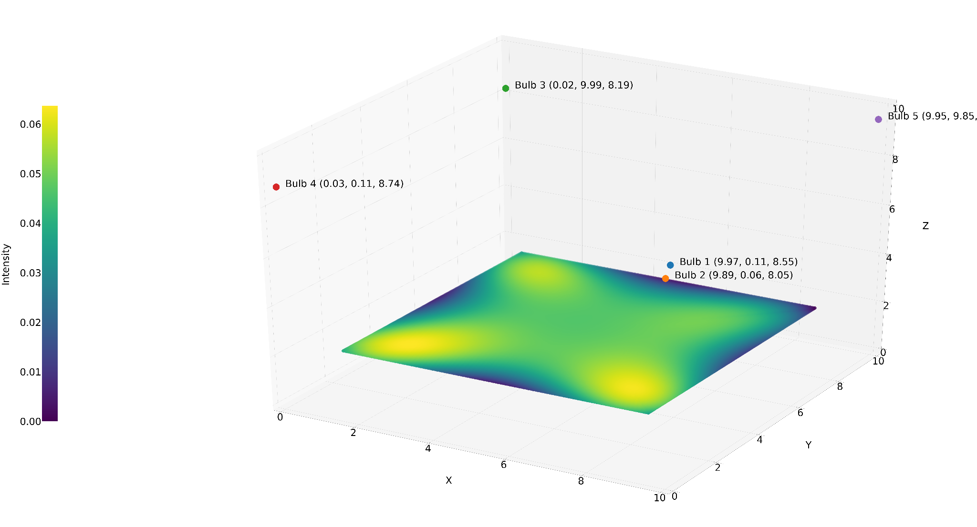
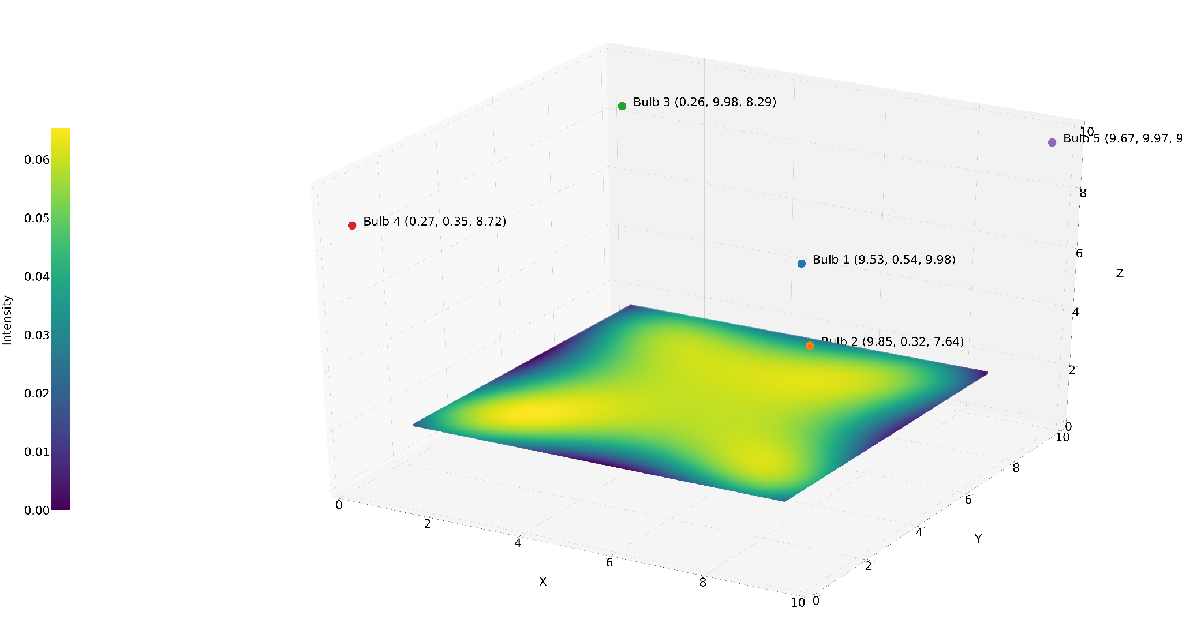
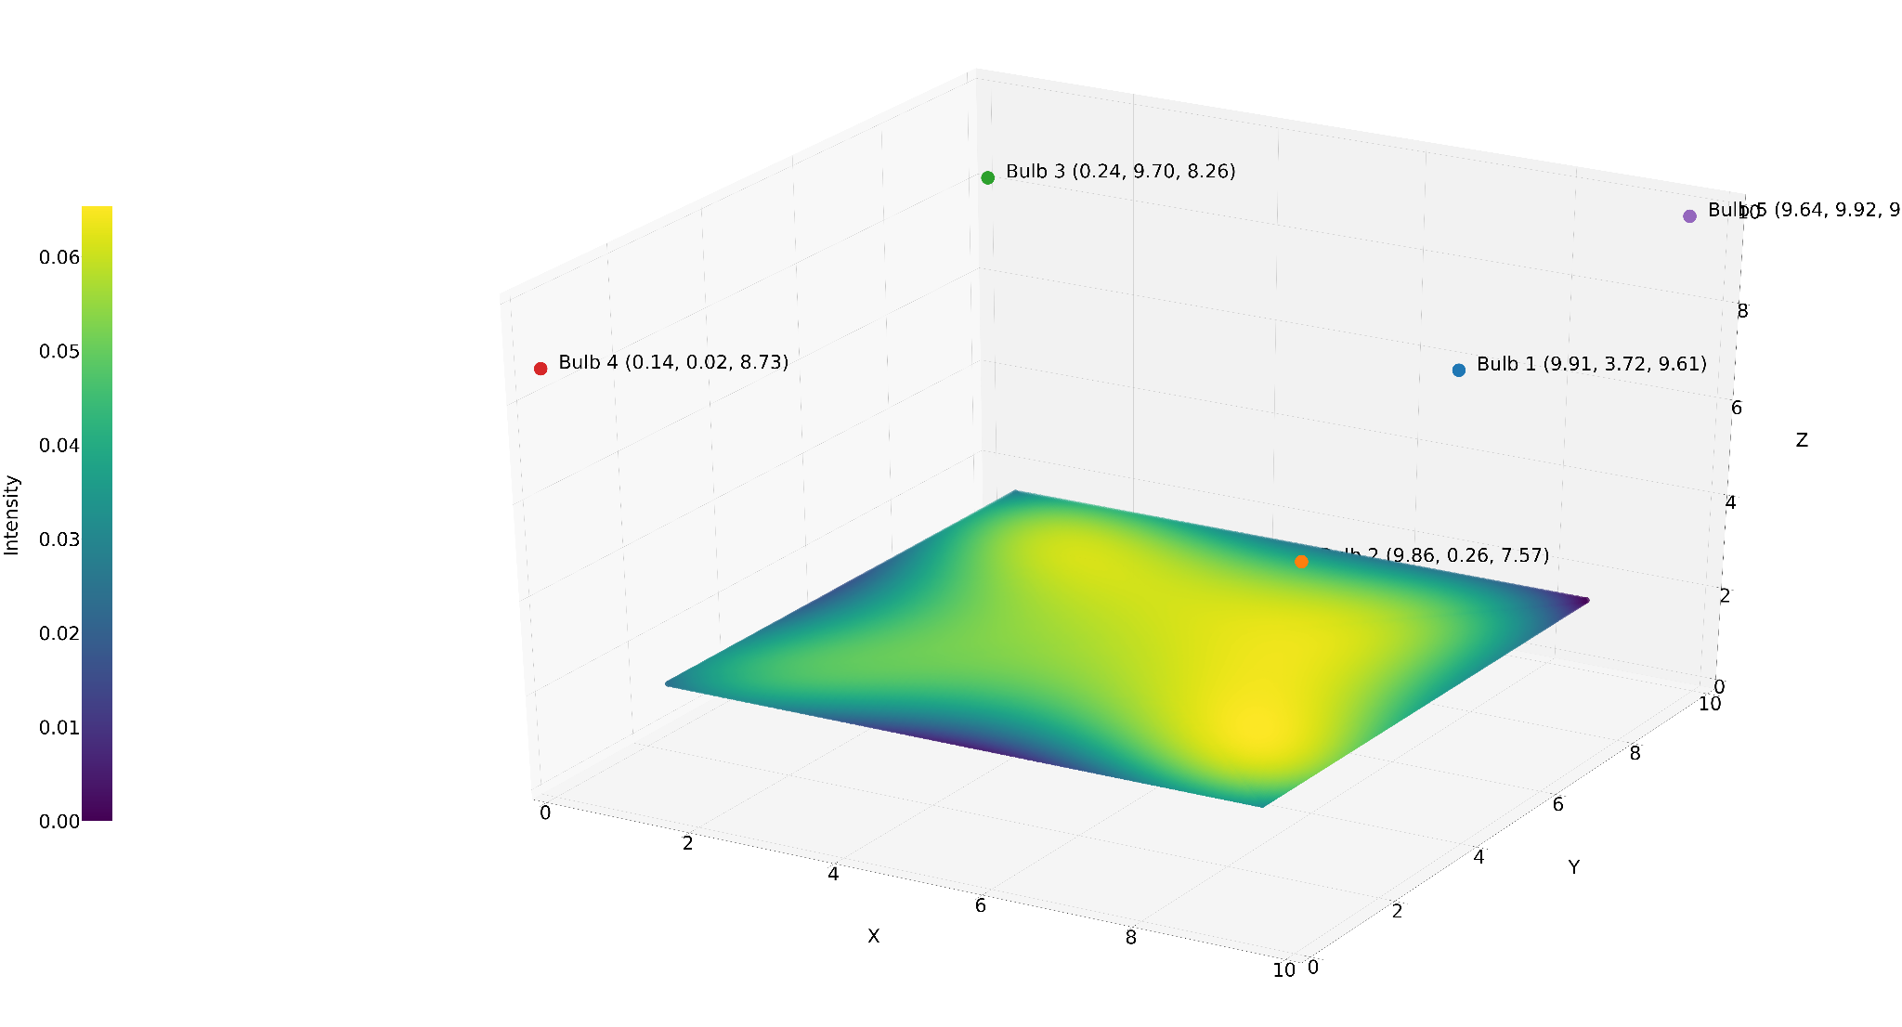
Changing n_bits

Slide 26
Advantages/Benefits of Genetic Algorithm
The concept is easy to understand.
GA search from a population of points, not a single point.
GA use payoff (objective function) information, not derivatives.
GA supports multi-objective optimization.
GA use probabilistic transition rules, not deterministic rules.
GA is good for “noisy” environments.
GA is robust w.r.t. to local minima/maxima.
GA is easily parallelised.
GA can operate on various representation.
GA is stochastic.
GA work well on mixed discrete/continuous problem.
Disadvantages of Genetic Algorithm
GA implementation is still an art.
GA requires less information about the problem, but designing an objective function and getting the representation and operators right can be difficult.
GA is computationally expensive i.e. time-consuming.

Slide 27
Conclusions:
·
Various hyper-parameters like random seed, number of iterations, number of bits, crossover probability and mutation probability have been tried and looked for maximum fitness value
Best set of parameters obtained as
Rando seed = 25
n_iter = 100
n_bits = 16
n_pop = 100
r_cross = 0.9
r_mut = 0.004166666667
The same was observed on the learning and intensity plots drawn for different set of parameters.
The best fitness or objective function value obtained was around 0.000417.

Slide 28
Simulated Annealing

Slide 29
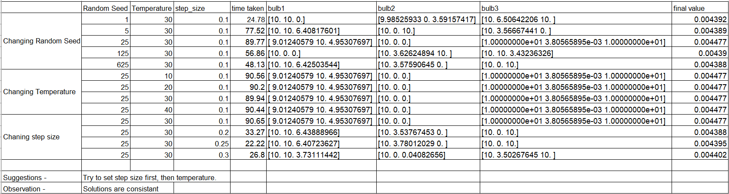

Slide 30
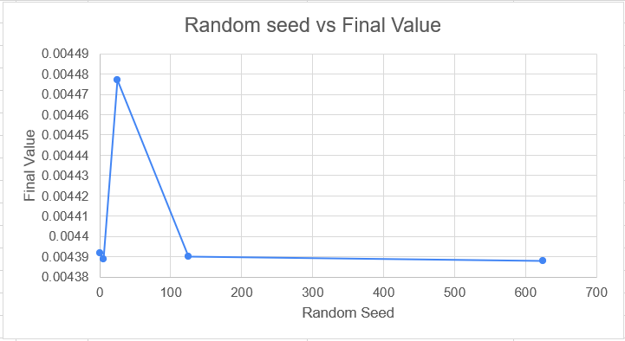
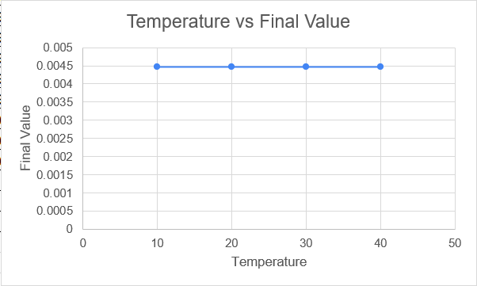
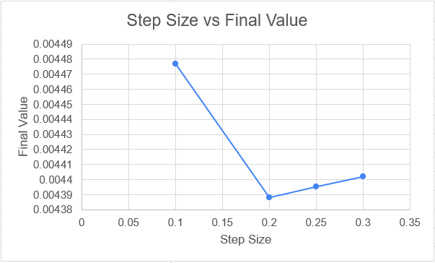

Slide 31
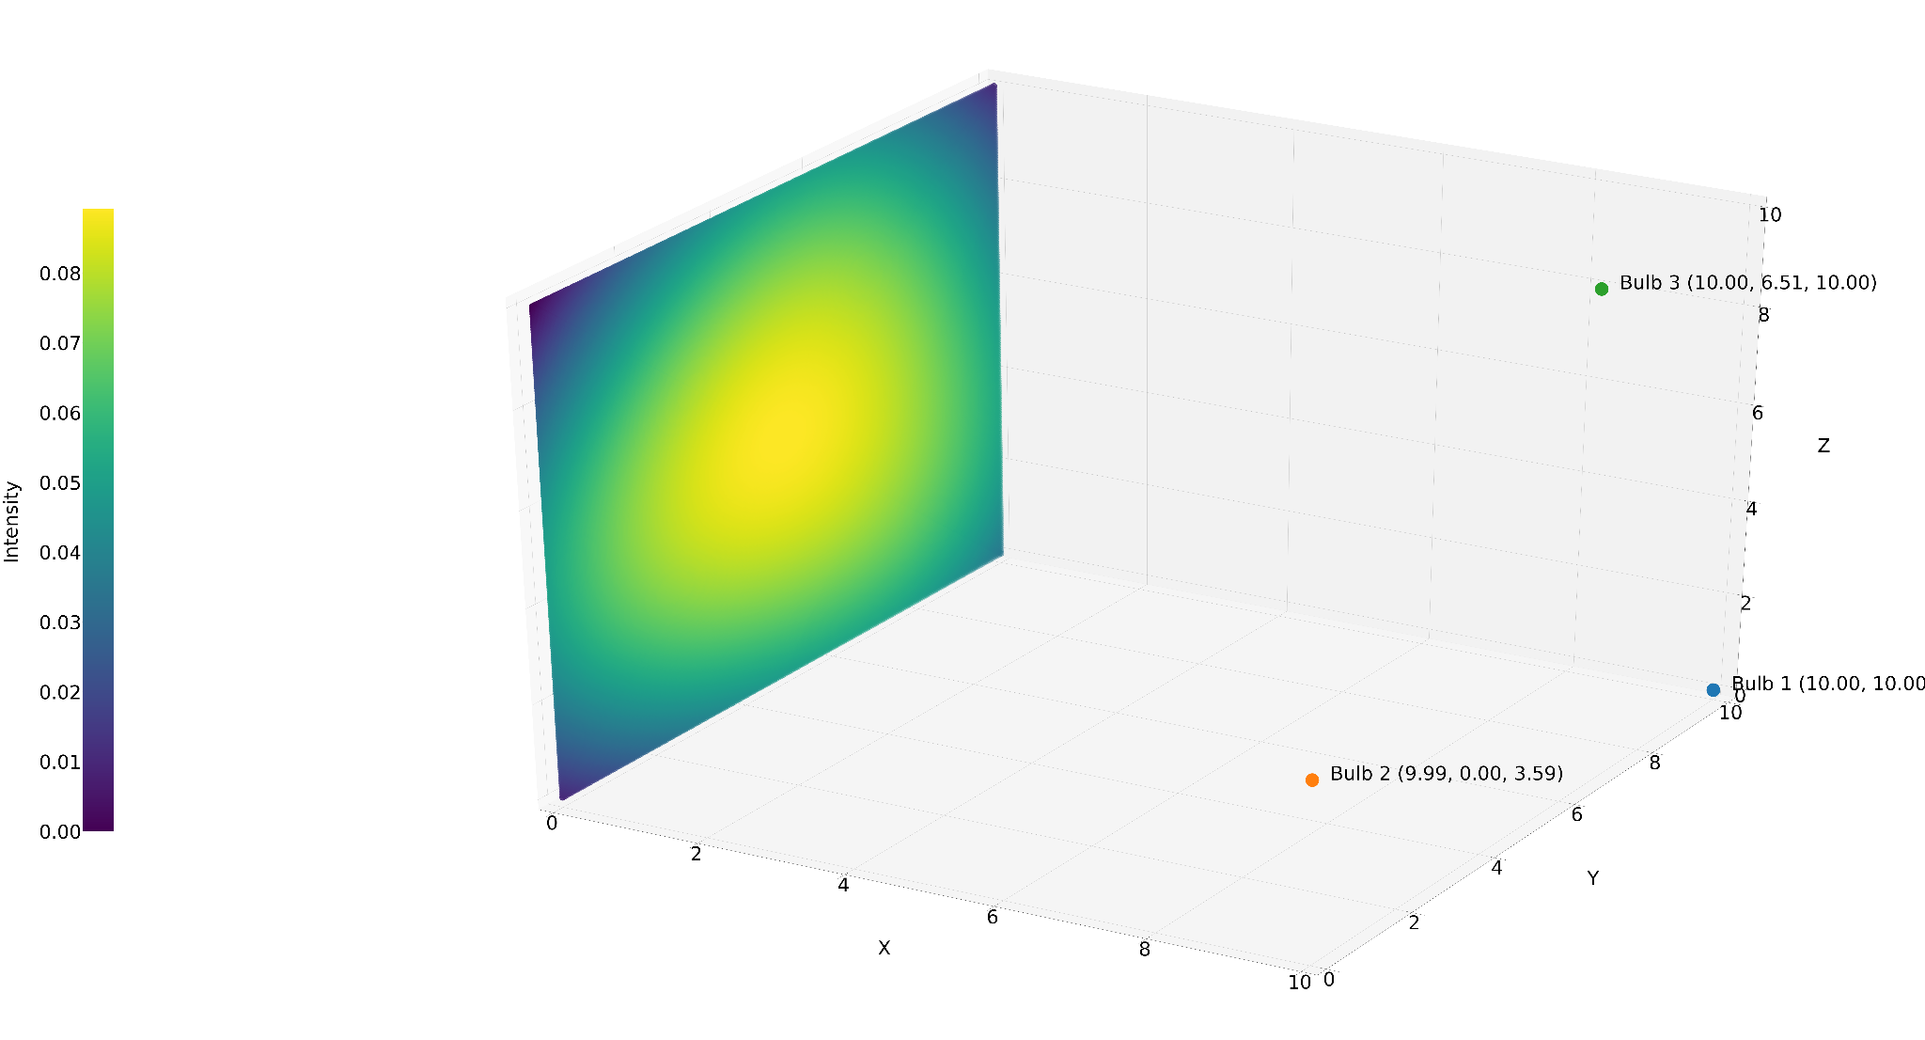
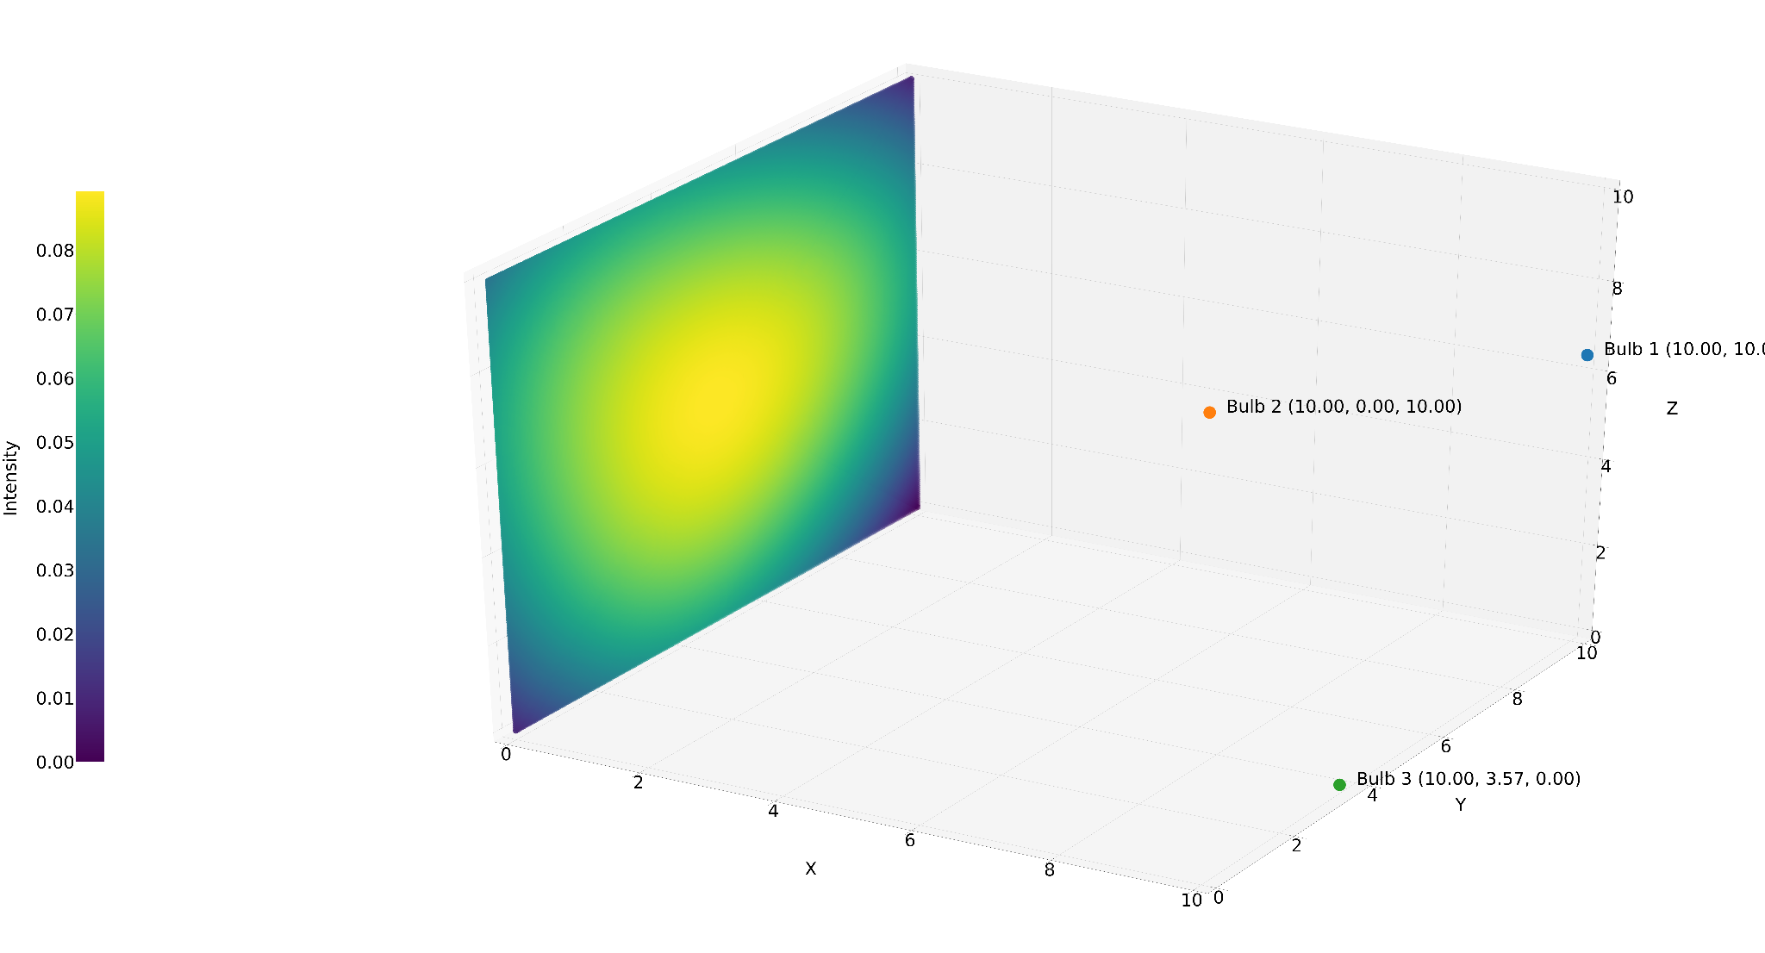
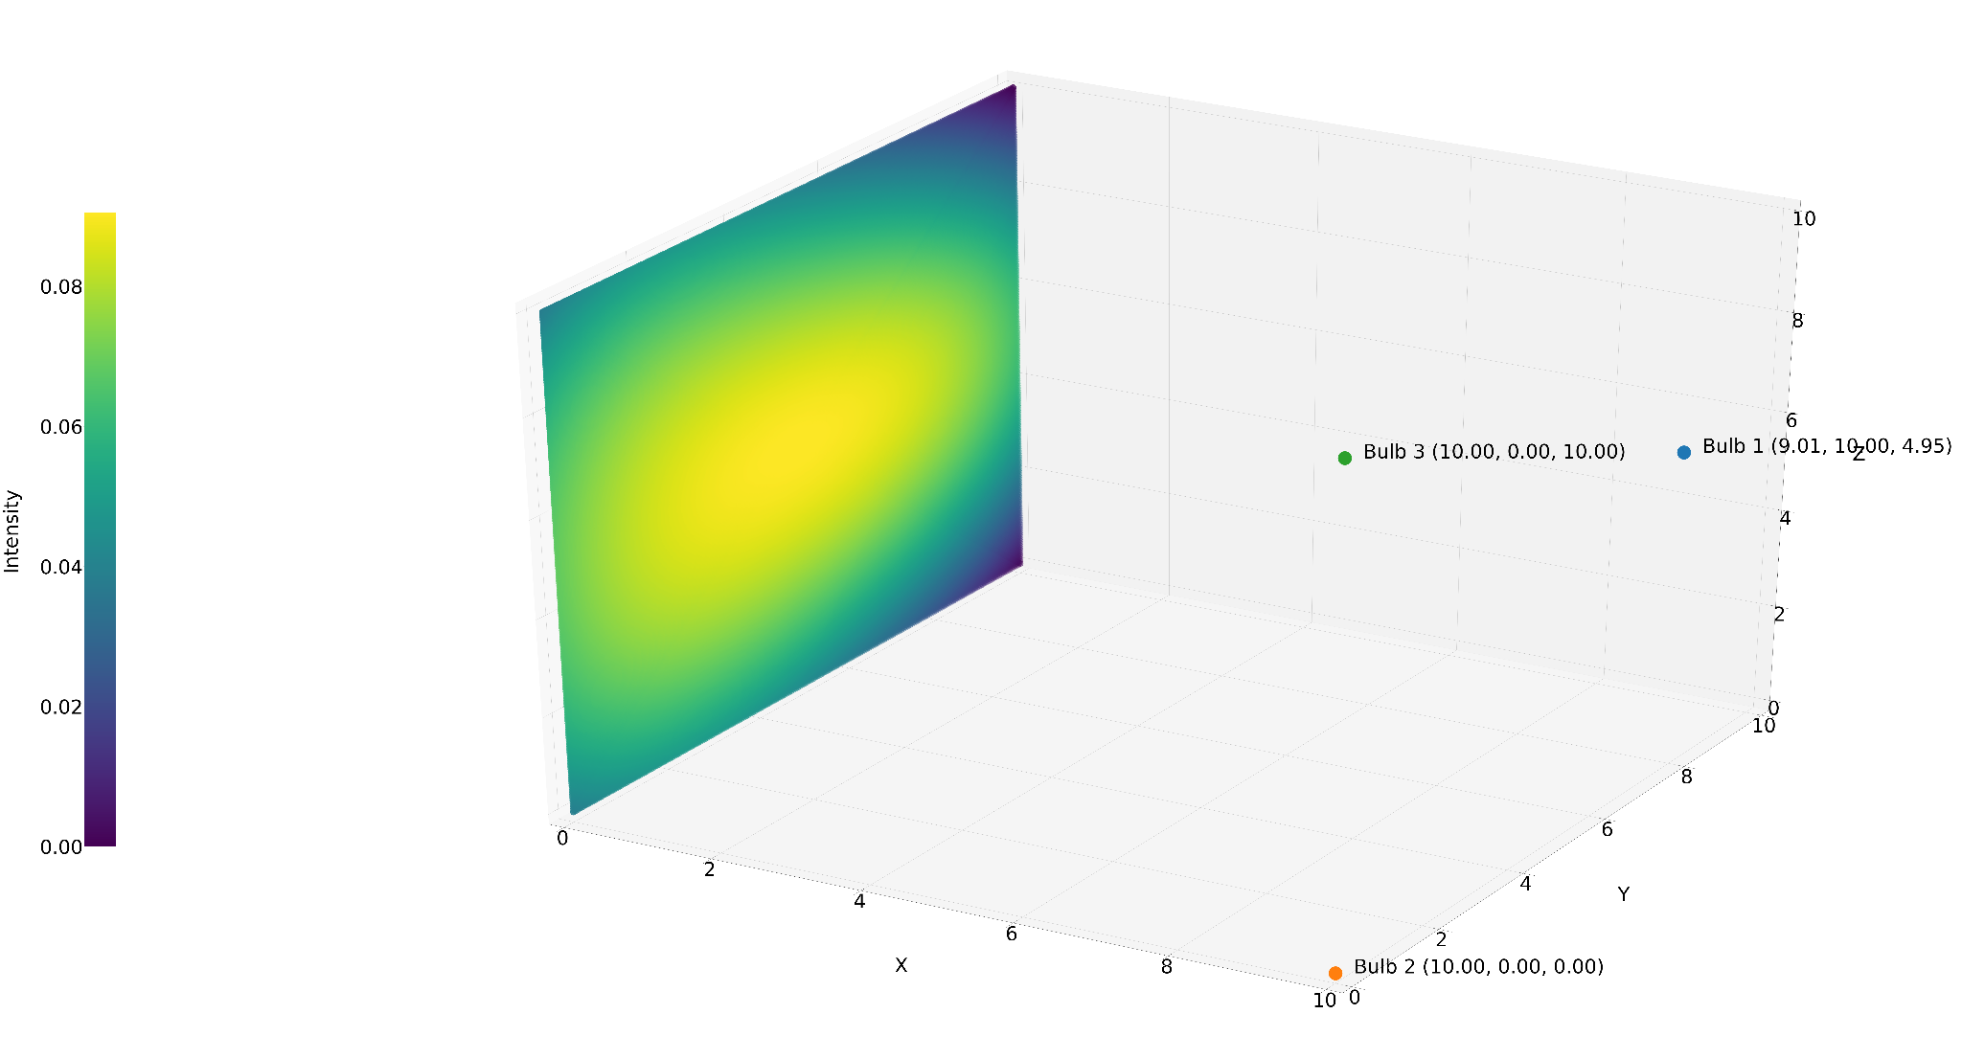

Changing Random Seed

Slide 32

Changing Temperature

Slide 33


Changing Step Size

Slide 34




Slide 35





temp / float(i + 1)
temp/float(1+50*temp)
temp/float(1+25*temp)
temp/float(1+100*temp)
Temp - 500
temp / 500

Slide 36






temp / float(i + 1)
temp/float(1+50*temp)
temp/float(1+25*temp)
temp/float(1+100*temp)
Temp - 500
temp / 500

Slide 37
Strengths
Simulated annealing can deal with highly nonlinear models, chaotic and noisy data and many constraints. It is a robust and general technique.
Its main advantages over other local search methods are its flexibility and its ability to approach global optimality. The algorithm is quite versatile since it does not rely on any restrictive properties of the model.
SA methods are easily "tuned". For any reasonably difficult nonlinear or stochastic system, a given optimisation algorithm can be tuned to enhance its performance and since it takes time and effort to become familiar with a given code, the ability to tune a given algorithm for use in more than one problem should be considered an important feature of an algorithm.
Weaknesses
Since SA is a metaheuristic, a lot of choices are required to turn it into an actual algorithm.
There is a clear tradeoff between the quality of the solutions and the time required to compute them.
The tailoring work required to account for different classes of constraints and to fine-tune the parameters of the algorithm can be rather delicate.
The precision of the numbers used in implementation is of SA can have a significant effect upon the quality of the outcome.

Slide 38
Conclusions:
·
Various hyper-parameters like random seed, Temperature, step size and number of iterations
Due to callback function, number of iterations doesn’t matter as long as it’s big value
Best set of parameters obtained as
T = 30
Step size = 0.25
For same initial conditions provided by user, change in temperature doesn’t matter much. But it’s always advisable to keep the value of temperature little high (like 30 in this case)
Whereas, changing the step size affects the time taken to converge on solution. We can see significant decrement in time taken when the step size is changes from 0.1 to 0.2

Slide 39
Particle Swarm Optimisation

Slide 40


Slide 41




Slide 42




Changing Random Seed

Slide 43



Changing Iterations

Slide 44




Changing Population

Slide 45
Advantages
Can be simple to implement
Have few parameters to adjust
Able to run parallel computation
Can be robust
Have higher probability and efficiency in finding the global optima
Can converge fast
Do not overlap and mutate
Have short computational time
Can be efficient for solving problems presenting difficulty to find accurate mathematical models
Disadvantages
Can be difficult to define initial design parameters
Cannot work out the problems of scattering
Can converge prematurely and be trapped into a local minimum especially with complex problems

Slide 46
Conclusions:
Other hyperparameters: w(inertia weight), phi1(acceleration coefficient dependent upon personal best solutions), phi2(acceleration coefficient dependent upon socially group’s personal best solution)
According to the paper by M. Clerc and J. Kennedy, for standard Particle Swarm Optimization, Best parameters are phi1=phi2=2.05(verifies phi1+phi2>4) and w=2/(|2 - phi1-phi2 - sqrt((phi1+phi2)^2 - 4(phi1+phi2))|) which comes as w=0.7298437. We used these values and got nice and fast results.
Inertia Weight which is ‘w’ for higher values allows particles to explore more space and for lower values, particles converge faster rather than exploring solution space much. So, we can initialise high w initially and decrease it after each iterations.
C1 is acceleration coefficient dependent upon personal best previous solutions of respective particle whereas c2 depends upon global best solutions. Thus, higher c1 allows particle to explore more by its personal best solution rather than global ones. For this high c1, if our c2 is low, particles will initially not depend upon other particles for their swarming. As we iterate, if we decrease c1, particles who have already explored more of solution space will now not explore much than before. This combined with high c2 will allow particles to consider solutions of other social particles resulting in convergence at the end.
Concluding this, We can start with high c1, high w and low c2. As we iterate, we should decrease c1, w and increase c2.

Slide 47
For achieving this, we can chose these 3 hyperparameters as:
w= 0.4(i-n)/n^2 + 0.4; w converging to 0.4
c1= -3i/n + 3.5; c1 initially 3.5 decreasing to 0.5
c2= 3i/n + 0.5; c2 initially 0.5 increasing to 3.5
For a test case, M. Clerc and J. Kennedy standard values takes around 23stime. Whereas, for these changing hyperparameters over iterations took much longer around 123s with different solution than previous but almost same final objective value. This happens because we will be changing these hyperparameters during iterations, more particles tend to replace their initial solution with newer ones.
Thus, it is better to use those standard values for saving up computational load and time.

Slide 48
Visual Representation of final results

Slide 49

BenchMarking - Ackely Function
Global Minima at x,y = (0,0)
Genetic Algorithm - f([0.0, 0.0]) = 0.000000
Simulated Annealing - f([-0.0005088, -0.0025955]) = 0.007667
Particle Swarm - f([-0.000145, -0.0025955]) = 0.000577

Slide 50
BenchMarking - Himmel Blau’s Function
Identical Minimas at x,y = (3,2), (-2.8,3.13), (-3.779,-3.28), (3.584,-1.84)
Genetic Algorithm - f([3.5844, -1.8481) = 0.000000
Simulated Annealing - f([ 3.58470499 -1.84973728]) = 0.000039
Particle Swarm - f([3.0000, 1.9993])= 0.000008

Slide 51




Inputs

Slide 52


Time Comparison with Standard Algorithms

Slide 53
Final Positions of Bulb

Slide 54



SHGO
Differential Evolution
Bulb 1 = [1.00000000e+01 3.80246108e-21 4.40534183e-21]
Bulb 2 = [10. 10. 3.58729436]
Bulb 3 = [10. 3.58729454 10. ]
Bulb 1 = [9.00346965 9.99985531 5.00902993]
Bulb 2 = [9.99374 4.14557906e-02 5.52104613e-04]
Bulb 3 = [9.99776711 0.02097781 9.99942581]
Bulb 1 = [ 9.99806779 10. 8.51740631]
Bulb 2 = [9.81437389 7.45276937 0. ]
Bulb 3 = [9.0766825 0. 6.46406701]
Dual Annealing

Slide 55



Particle Swarm
Simulated Annealing
Bulb 1 = [10. 3.59319166 10. ]
Bulb 2 = [10. 0. 0.]
Bulb 3 = [10. 10. 3.5872855]
Bulb 1 = [9.58680626 8.63555672 9.38580158]
Bulb 2 = [8.60934903 5.14140552 0. ]
Bulb 3 = [9.89335593 0.97572921 8.60382683]
Bulb 1 = [9.9882507, 5.535430, 6.808471]
Bulb 2 = [9.4955444, 0.018768, 6.742553]
Bulb 3 = [9.0220642, 9.625091, 0.627899]
Genetic Algorithm

Slide 56


Final Value of Objective Fn Comparison with Standard Algorithms

Slide 57


Error when compared to best result using standard Algorithm

Slide 58
Comparison of performance of 3 algorithms

Slide 59



Genetic Algorithm
Simulated Annealing
Particle Swarm optimiser

Slide 60



Genetic Algorithm
Simulated Annealing
Particle Swarm optimiser

Slide 61
Genetic Algorithm
Simulated Annealing
Particle Swarm optimiser

Slide 62



Genetic Algorithm
Simulated Annealing
Particle Swarm optimiser

Slide 63
Performance Matrix

Slide 64


Comparison of the three algorithms

Slide 65
Conclusion
Our problem statement was to optimize the positions of the an n(1-10) number of light bulbs in a 3D room so as to ensure uniform illumination on a convex polygon in the 3D space.
The problem statement was solved using three different optimization algorithms: Genetic Algorithm, Simulated Annealing and Particle Swarm Optimization Algorithm.
All the three approaches were verified using Himmelblau function and Ackley Function. These algorithms were able to approach one of the four minima of Himmelblau function in less than 3 seconds.
Hence, the all three optimization algorithms successfully solve the problem statement. Among those, Particle Swarm is the best algorithm for this problem statement

Slide 66
Team Members:
Rohit Nikam - 180010049
Shantanu Lahoti - 170010019
Vaibhav Takale - 170010024
Mamidipaka Manikanta - 193370007
Ronak Shah - 193370006
Spandan Patil - 180010055
Punit Manjani - 180010046
Atharva Telange - 180010014
Trideep Das - 170010015
Ammar Ahmad Qazi - 193100001
Thank You!

